Slide 1
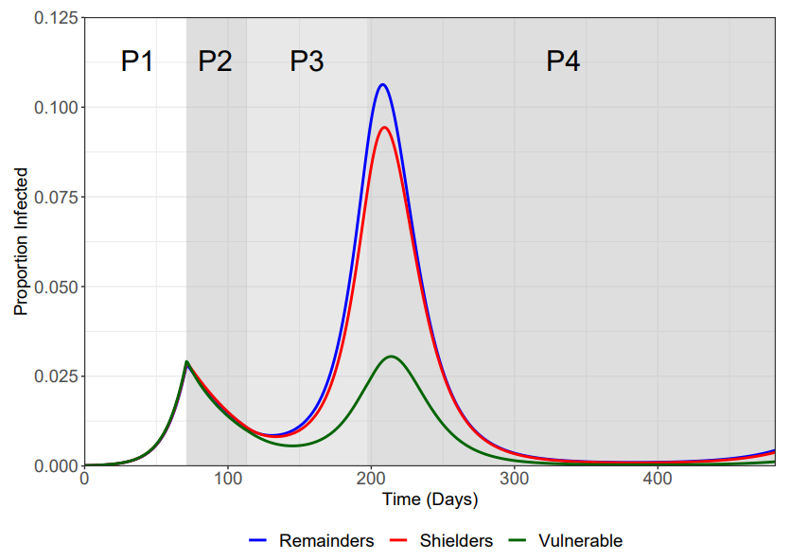
96/2/2 Model
2:2:1 Ratio

